Slide 1

MOBILE APPLICATION FRAMEWORK
By Viduth Tennakoon

Slide 2
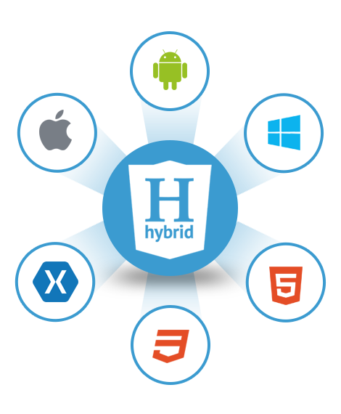
FRAMEWORK SOLUTION TO DEVELOP TODONOTES
I would use Hybrid App Development.
Because the app has low requirements, Faster initial speed to market so its better and we can use the same code on multiple platforms, It also cheaper than others so i think Hybrid app development is the best.

Slide 3

CONSIDERATIONS DONE WHEN DECIDING A MOBILE APPLICATION FRAMEWORK
Development costs
Performance
Security
Time to market
Maintaining costs
Availability
Hiring
UX UI design

Slide 4
NATIVE APP DEVELOPMENT
PROS | CONS
Native apps work even if there is no internet connectivity. | High cost of development
Native programming allows utilizing to the full the capabilities of both the device and the system it’s running | Time-Consuming Development
Native apps have very good Security & reliability | Native Apps Require Frequent Upgrades

Slide 5
HYBRID APP DEVELOPMENT
PROS | CONS
Hybrid apps are typically much faster to build | User experience should always be of utmost importance
A hybrid app is cheaper to create than a native app. | Performance issues
One Codebase, hybrid app can be built just once and released on both Android and iOS. | Connection Limitations, Because they’re essentially websites, hybrid apps don’t work offline.

Slide 6
PROGRESSIVE WEB APPS
PROS | CONS
PWA's are responsive to any and every device. Desktops, tablets, mobiles and any other device. | Logging into your PWA using another application such as Facebook or Instagram is not supported using this technology.
Offline connectivity. | No download store
They work for any web browser. | Limited access to your other applications

Slide 7

A VALUE-ADDED FEATURE FOR “TODONOTES”
Edit Button
I think its better to have a edit button in case you go wrong, and you can edit it. It can make the user work easier.

Slide 8
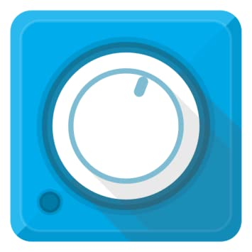
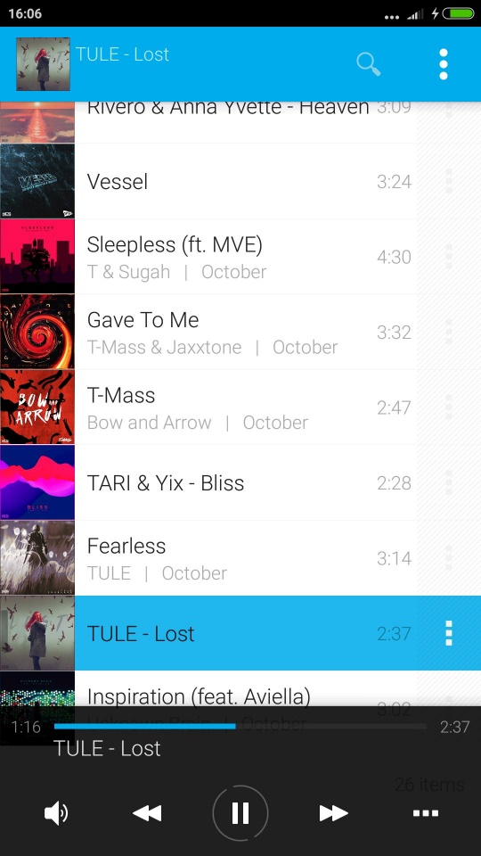
FAVORITE MOBILE APPLICATION
Avee Music Player (Lite)
Its a lightweight music player with folder browsing, equalizer, song cross-fading, and video playback capability. Most notable features include audio visualizer and easy HD video production. You can also import and export visualizer templates as files and find various other ones shared online.
The best thing I like about this app is the Ui & Ux , this app is so simple that everything you need is just one slide away.
Features: * Most popular media formats supported * Direct folder browsing with folder shortcuts * Customizable audio visualizers. * Export visualizer as hd video file. * Searchable library, queue, files, * Screen orientation lock * Read and save playlists (pla, pls, mpcpl, plp, m3u, m3u8) * Lock-screen and status bar widget * Supports media and blue-tooth controls * Sleep timer * Equalizer * Cross-fade and gap-less transitions * UI color skins * 2 types of internal players

Slide 9
REFERENCES
https://drive.google.com/file/d/1yKw_GxBDuvZdejMh0Thb8GnnVSNjA30k/view?us p=sharing

